Slide 1
The Anatomy of DH Projects

Slide 2
What:
Anatomy of DH Projects
Why:
Design & evaluation of DH projects specifically
Design & evaluation of projects (digital and otherwise) more generally
Understanding of knowledge production in digital environments

Slide 3
TOPIC: Primary Material & Research Question
DATA: Collecting& Modelling & Describing & Analyzing
Technologies
Audience, Presentation, User Experience
People and Institutions

Slide 4
TOOLS & TECHNOLOGIES

Slide 5
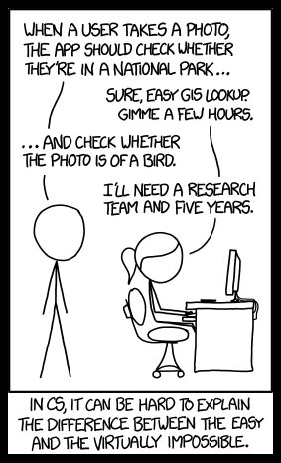

Slide 6
Technology in DH
New or existing? Software ecology?
Open-source?
GNU General Public License (GPL): source code for an application is freely available for study & modification– “as long as further developments and applications are put under the same licence
Widely adopted? By your colleagues/ collaborators?
User base: humanities? Industry? Institutions?
Prerequisites:
Data formats
Tech stack (other software)
Server space
Training

Slide 7
Affordances
Affordances of a technology = properties of a technology that enable certain tasks; tasks that users can perform with a technology (e.g. query, search, analysis, visualization)
"affordance, n." OED Online. Oxford University Press, December 2016. Web. 6 February 2017.

Slide 8
CHOOSE YOUR OWN ADVENTURE
What is your project?
Transcribing, Editing, Collating
TEI P5 (XML) & XSLT
T-Pen; Tradamus; Manuscript Viewing Tools (Mirador); Viscoll
Discovering, Cataloguing, Representing
Exhibit
Database
Visualization
Omeka
.csv (Excel)
SQL
Drupal
Network
Map
Other
Gephi, Cytoscape, Palladio
ArcGIS, QGIS, CartoDB
NeatLine (Space + Time), Palladio
VisColl (Penn), Raw
MS Access
Filemaker Pro
Based in part on Miriam Posner’s blog post, How did they make that?

Slide 9
Users, readers, communities

Slide 10
Technology-in-practice (Wanda Orlikowski)
User community
Technology-in-practice
Organizational culture
Technology

Slide 11
The notion of “technology-in-practice” suggests that the technology is not just the machinery, digital or analog, but on the one hand the organizational or institutional culture around it and on the other hand, the needs and practices of its user community. Organizational culture and user community create a “behavioural and interpretive template” for the use of a technology.
Technology-in-practice: not only the technology itself, but “the ways it is extended, adapted, used, and misused by a specific user community—whether by ignoring an entire set of functions, or by extending its functionality through plugins or customizations, or by using it for purposes never foreseen by its designers. More briefly, technology-in-practice is “what people actually do with the technological artifact in their recurrent, situated practices.” (Orlikowski, Wanda J. “Using Technology and Constituting Structures: A Practice Lens for Studying Technology in Organizations.” Organization Science, vol. 11, no. 4, 2000, pp. 404–428. www.jstor.org/stable/2640412.)

Slide 12
Technology-in-practice (Wanda Orlikowski)
Technology in Practice
Data + software
Disciplinary scholarly community
Institutional concerns & constraints
DH: technology-in-practice is software and data as used by scholarly communities of practice, within institutional and disciplinary concerns and constraints, in conversation with audiences.

Slide 13
Users & Intended Audiences
[E]ven doorknobs have politics in that they may be round, requiring a human hand to turn them, or shaped as levers, such that a person with a prosthetic limb or an armload of groceries with one free elbow can still successfully use them. This is more than simply a matter of utility. Both designs are political in that they presume and construct different kinds of worlds, with the round doorknob presuming a world in which everyone’s bodies are the same, and in which hands with opposable thumbs and sufficient grip strength are always available (Galey, Alan, and Stan Ruecker. “How a Prototype Argues.” Literary and Linguistic Computing 25.4 (2010): 405-24. Web. 6 Feb. 2017).

Slide 14
What groups of users/readers are invited in? What groups of users/readers are shut out?
Consider:
expertise & interest; scholars & laypersons
use of e.g. assistive technologies like screen readers, speech recognition, close captioning, etc.
level of technical training (or lack of it)
limited access to (powerful) computers
limited internet bandwidth
Tradeoffs & compromises

Slide 15
User Experience, Interfaces, & Display
UX (user experience) & usability testing
User stories: descriptions, from a user’s perspective, of a tool: who they are, what they want the tool to do, in what order…

Slide 16
data

Slide 17
Humanities Data
Images & Maps
Sounds & Music
Films
Live or Digital Performances
Words, Languages, Grammars
Text
Social Media Archives

Slide 18
Humanities Data
Semistructured
TEI-encoded text
Unstructured
A corpus of literary texts
Structured
Spreadsheet of catalogue entries
GIS data of locations on a map

Slide 19
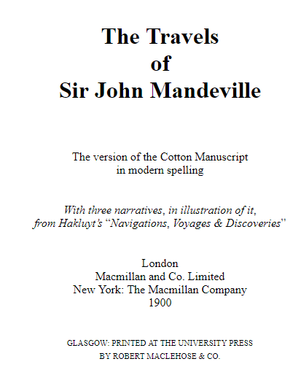
Humanities Data: Unstructured

Slide 20
Humanities Data: Semi-structured
<msDesc> <msIdentifier> <settlement>Oxford</settlement> <repository>Bodleian Library</repository> <idno>MS. Add. A. 61</idno> </msIdentifier> <msContents> <p> <quote>Hic incipit Bruitus Anglie,</quote> the <title>De origine et gestis Regum Angliae</title> of Geoffrey of Monmouth (Galfridus Monumetensis): beg. <quote>Cum mecum multa &amp; de multis.</quote> In Latin.</p> </msContents> <physDesc> <p> <material>Parchment</material>: written in more than one hand: 7¼ x 5⅜ in., I + 55 leaves, in double columns: with a few coloured capitals.</p> </physDesc> </msDesc>

Slide 21
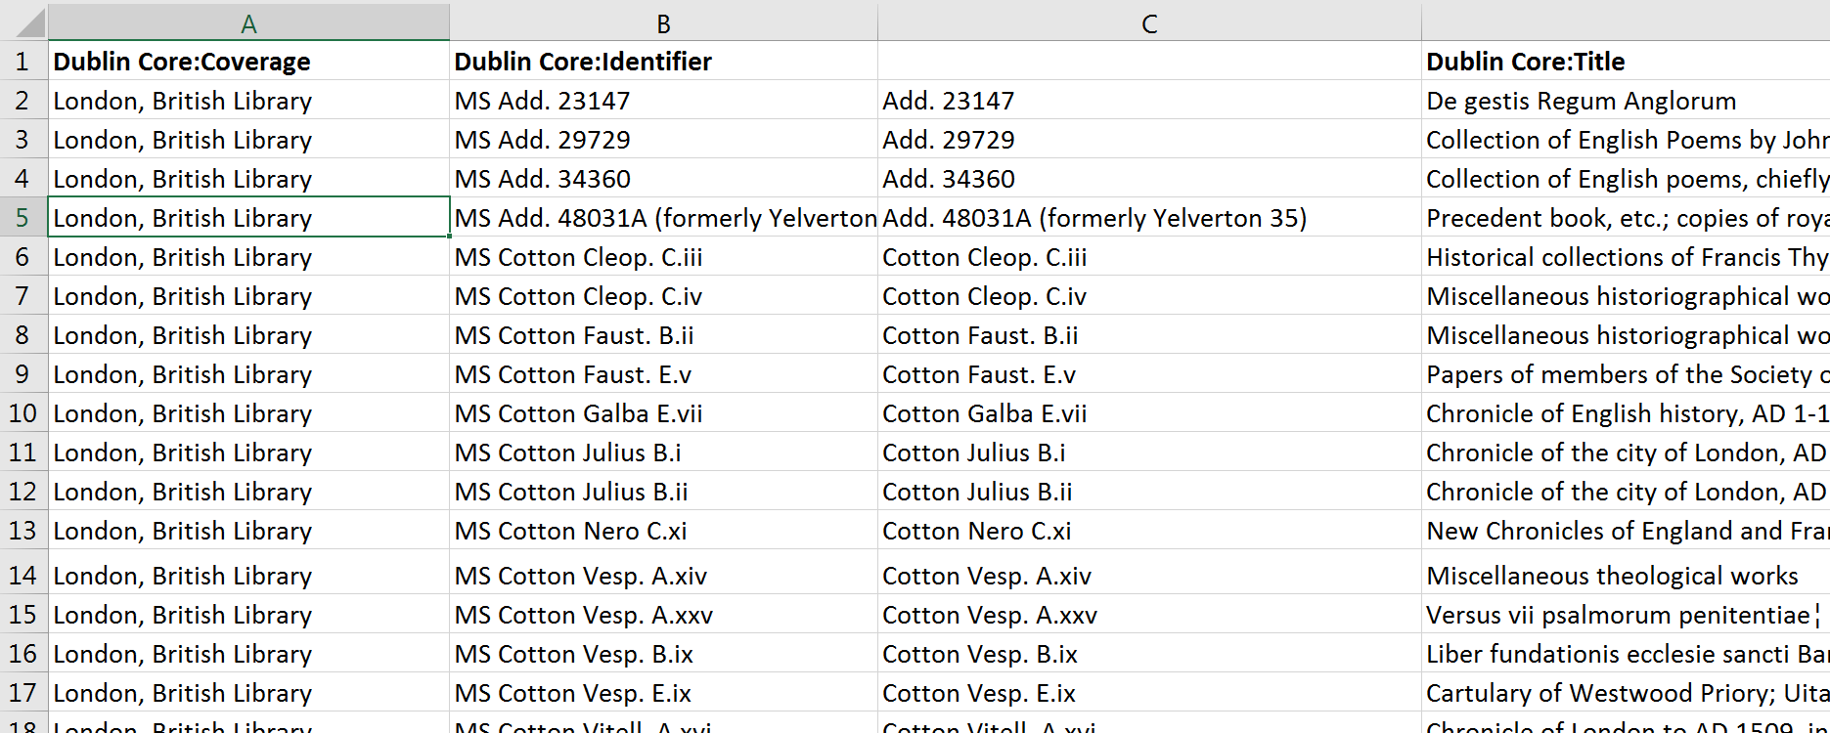
Humanities Data: Structured

Slide 22
Humanities Data
Semistructured
TEI-encoded text
Unstructured
A corpus of literary texts
Structured
Spreadsheet of catalogue entries
GIS data of locations on a map

Slide 23
Humanities Data
“Big? Smart? Clean? Messy?” (Christof Schöch)
“Computationally tractable” (Miriam Posner)

Slide 24
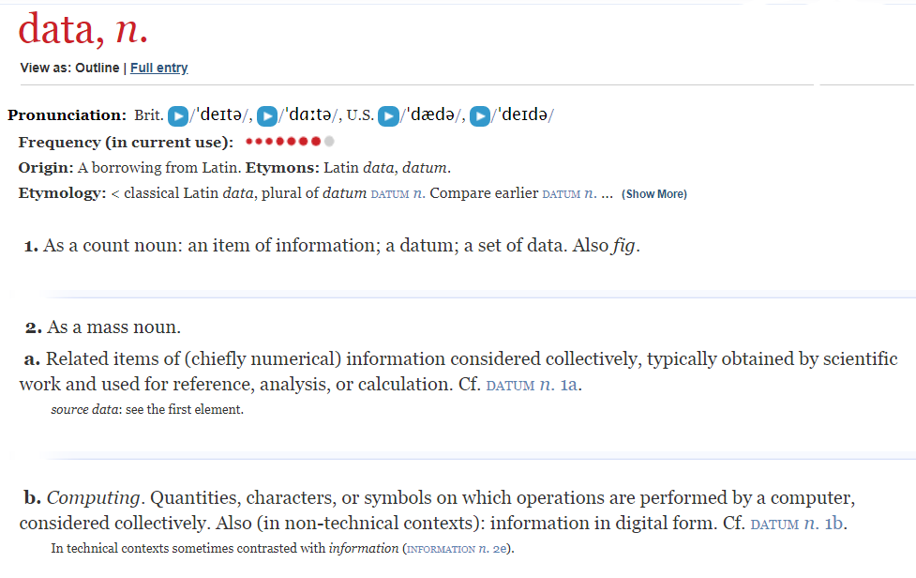

Slide 25
Humanities Data:
What “counts” cannot necessarily be counted
Data representation = interpretation:
The process of modelling and collecting our data is an interpretive process that is shaped by our choices re. what aspects of the data we model; by our research question, argument, perspective, discipline, social context, institutional context, tools available etc.

Slide 26
Humanities Data: Drucker
Sciences vs. humanities: “assumptions of knowledge as observer-independent and certain, rather than observer co-dependent and interpretative. […] To begin, the concept of data as a given has to be rethought through a humanistic lens and characterized as capta, taken and constructed.” (Johanna Drucker, “Humanities Approaches to Graphical Display.”)

Slide 27
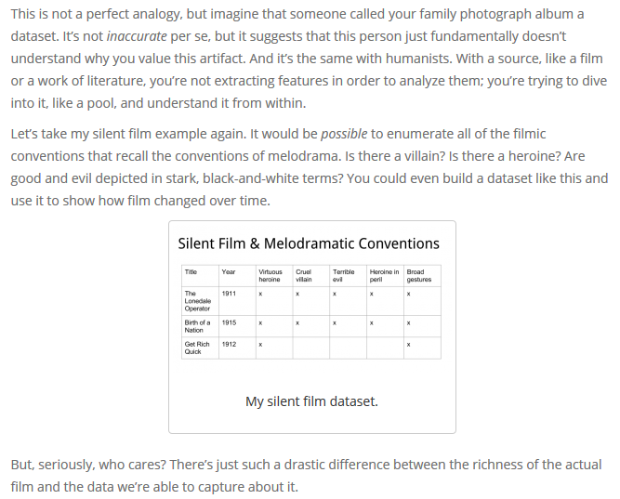
Humanities Data: Posner

Slide 28
Humanities Data: Posner
“When you call something data, you imply that it exists in discrete, fungible units; that it is computationally tractable; that its meaningful qualities can be enumerated in a finite list; that someone else performing the same operations on the same data will come up with the same results. This is not how humanists think of the material they work with.” (http://miriamposner.com/blog/humanities-data-a-necessary-contradiction/)

Slide 29
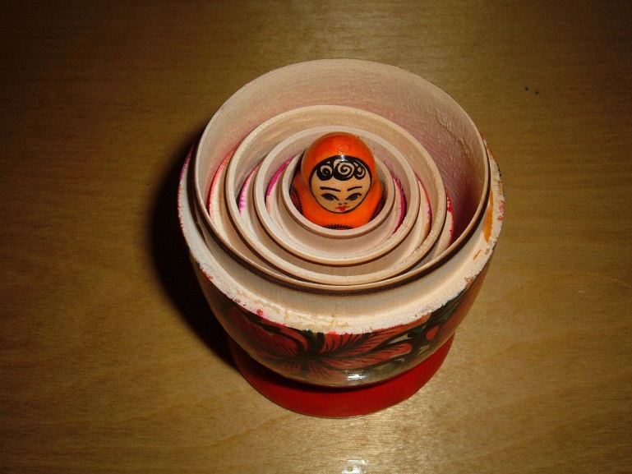
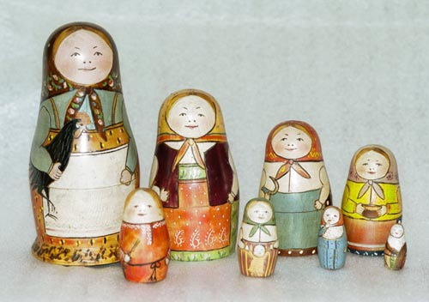
Humanities’ Data
Humanities’ data has depth in small universes. Our material has the capacity to unfold inwards, as it were, to disclose layer upon layer of insights and connections, within a comparatively tiny amount of data--almost an inverse matryoshka, as it were, where each inner doll is bigger and more complex than the one encasing it.
Photo: BrokenSphere - Own work, CC BY-SA 3.0, https://commons.wikimedia.org/w/index.php?curid=3773186
Doll carved by Zvezdochkin, painted by Malyutin - Sergiev Posad Museum of Toys, Russia, Public Domain, https://commons.wikimedia.org/w/index.php?curid=5051554

Slide 30
Data Models
Data model: abstract representation of things or processes
Data model: choice of virtual entities, relationships, properties/aspects → “toy universe”
Data model: top row of your spreadsheet

Slide 31
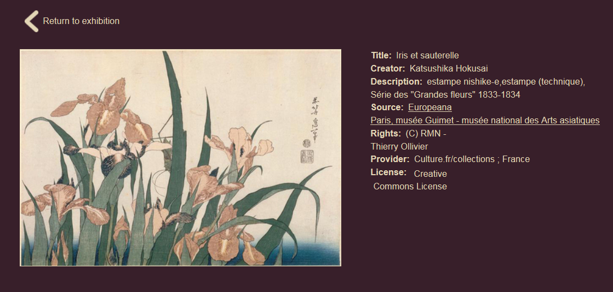
Metadata
Metadata is structured data describing data. Think Author, Title, Date, Subject in your online library catalogue
Standard metadata schemas include Dublin Core, MARC, and MODS (each of these schemas has a different set of information it collects).
Europeana Art Nouveau Exhibition. Individual record: Hokusai, Iris et sauterelle.
Individual item metadata includes title, creator, description, source, rights, etc: the elements of the Dublin Core metadata schema.
Notes:
Each record of an archive is described by metadata: structured data about data. For example, think about your library’s online catalogue: it contains the records of books, with fields like Author, Title, Publisher, Editor, Date. If you use standard metadata schemas, like Dublin Core, MARC, or MODS, your data will be discoverable and interoperable with aggregators and library catalogues.

Slide 32
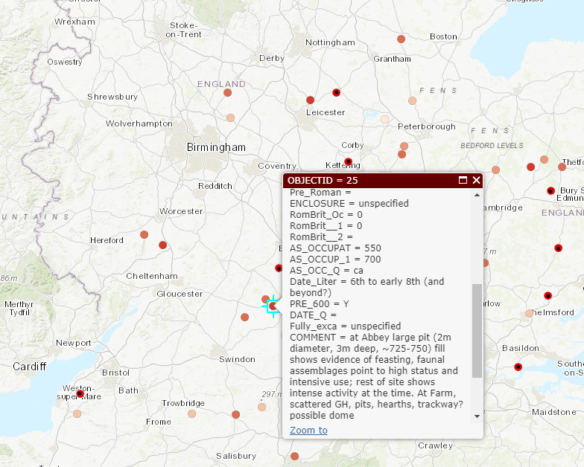
Custom metadata schema: Digital Atlas of Roman and Medieval Civilizations (Anglo-Saxon Rural Settlements: Eynsham)

Slide 33
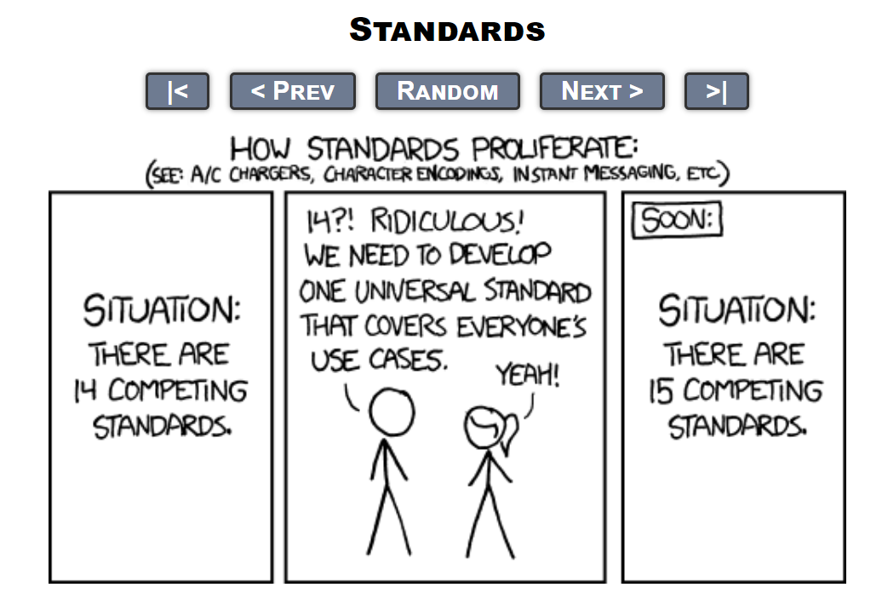
Metadata Standards

Slide 34
Controlled vocabulary: there are 50 possible literal values to describe this one entity (e.g. chairs: desk chairs, rolling chairs, step stools, kitchen table chairs); may include categorization
Ontology: making explicit the relationships between values in controlled vocabularies

Slide 35
Chairs
No legs
Rock
One leg
Bar stool
More legs
Three-legged stool
Desk chair
Rolling chair

Slide 36
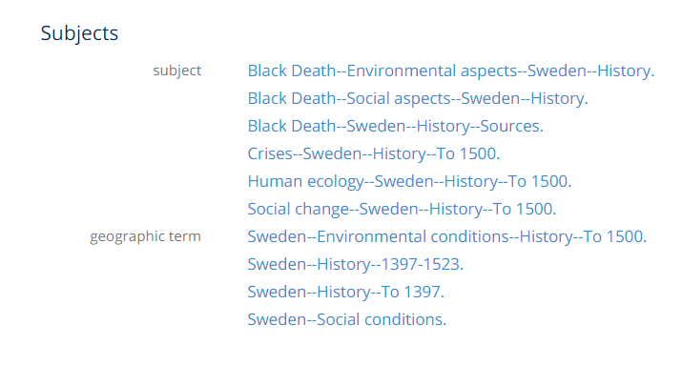
Controlled Vocabulary
“A controlled vocabulary is an organized arrangement of words and phrases used to catalog content and/or to retrieve content through browsing or searching. It typically includes preferred and variant terms and has a defined scope or describes a specific domain. […] While capturing the richness of variant terms, controlled vocabularies also
promote consistency in preferred terms and the assignment of the same terms to similar content.”
(http://www.getty.edu/research/publications/electronic_publications/intro_controlled_vocab/what.pdf)

Slide 37
Authority Control
The practice of systematizing controlled vocabularies so descriptors of entities are unique, non-overlapping, and consistently used--e.g. having an accepted set of “correct” subject headings

Slide 38
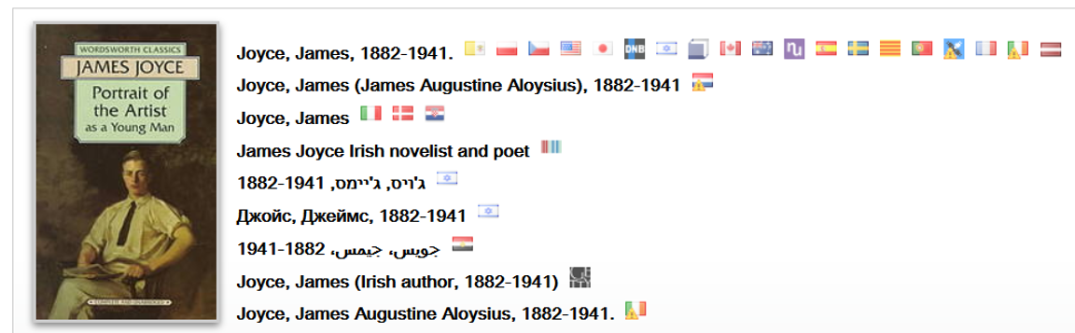
James Joyce

Slide 39
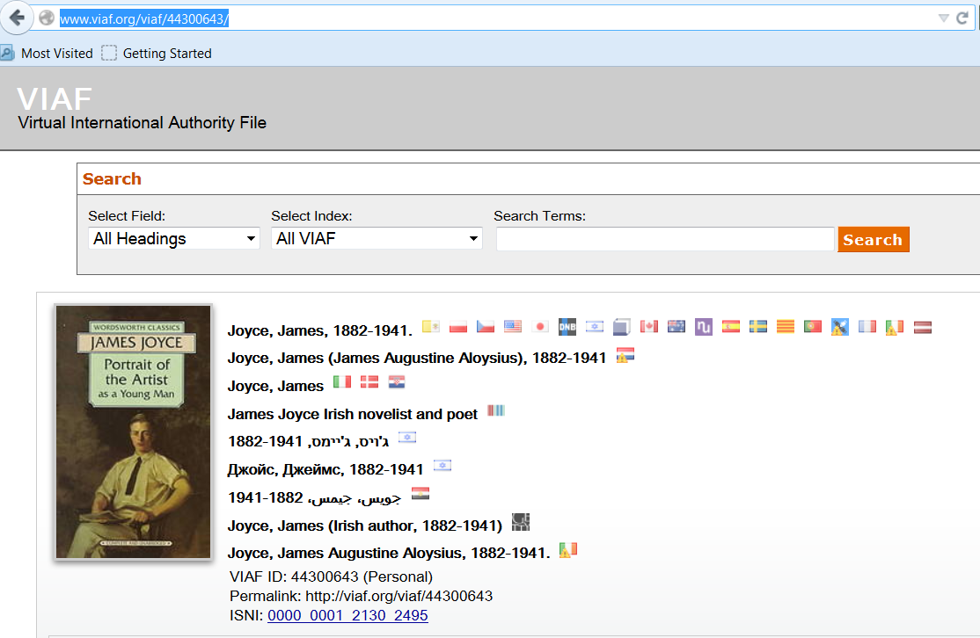
James Joyce: unique resource identifier

Slide 40
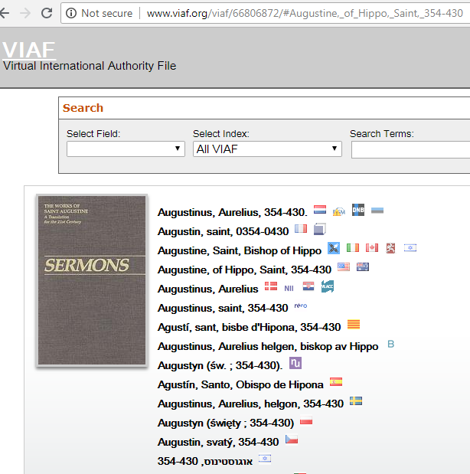

Slide 41
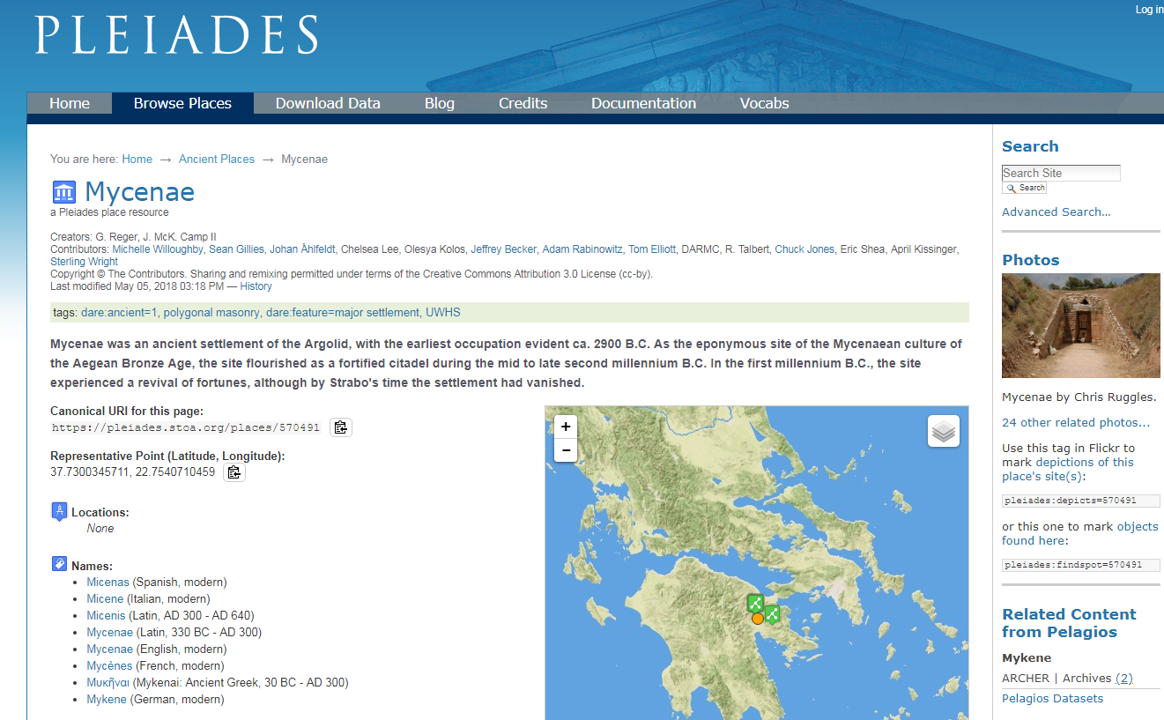
Gazetteers: place name dictionaries + maps + atlases + URIs
Notes:
https://pleiades.stoa.org/places/570491

Slide 42
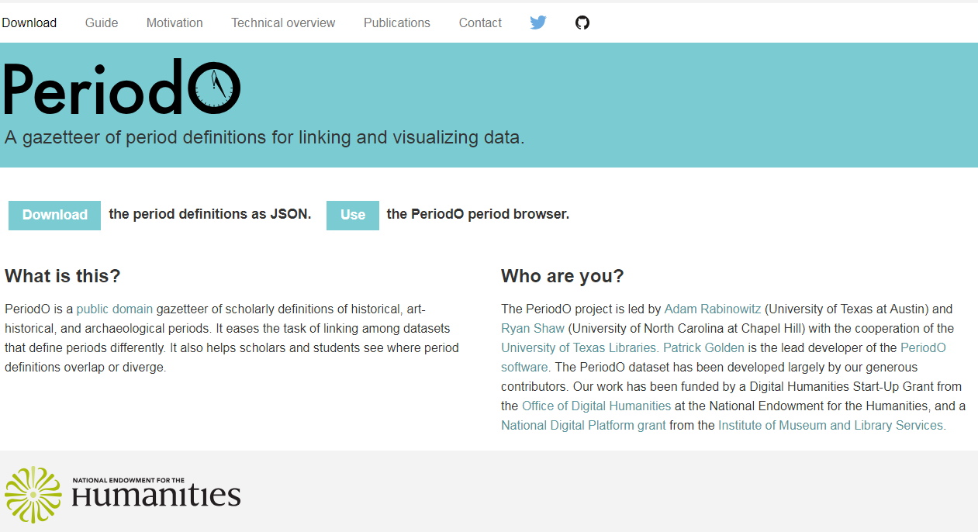
Gazetteers: Time

Slide 43
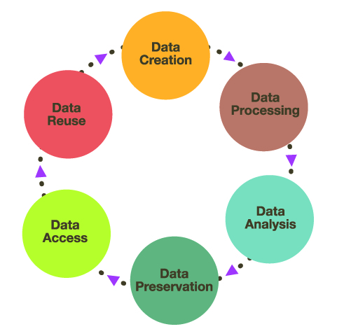

Research Data: Life Cycle
Research Data Life Cycle: https://blogs.ntu.edu.sg/lib-datamanagement/data-lifecycle/

Slide 44
Research Data: Life Cycle
Identify a small subset of meaningful data
Collect & describe data
Analyze your data
Publish/share your conclusions & data
Create a data model
Revise data model
Go back and pick up what you missed

Slide 45
“Data is always a partial representation of the object of study” (Schoch)
Failure-, incompleteness-, and pessimism-based approaches to data collection, modelling, analysis, and preservation

Slide 46
Preservation-Ready Data
Data: accessible, usable, readable, preservable
Human-readable and human-editable
Separable from technical platforms
Described via metadata standards used in your discipline
Contextualized in clear documentation
Housed in non-proprietary, open source standards and technologies
Saved in, or reducible to, simple formats: .txt, TEI P5, .csv, JSON, .pdf, .jpg, tiff
Embedded in your disciplinary community

Slide 47
TOPIC: Primary Material & Research Question
DATA: Collecting& Modelling & Describing & Analyzing
Technologies
Audience, Presentation, User Experience
People and Institutions

